Slide 1
Angular 2
Framework

Slide 2
Key Points For Today Session
What is a Angular Js ?
What is the main benefits of Angular Js ?
What is the difference between Angular js 1 and Angular js 2 ?
Structure of Angular Js ?
Choose of Language|Editor ?

Slide 3
Key Points For Today Session
Introduction of Components.
Template, Interpolation and Directives.
Data Binding and Pipes.

Slide 4
What is Angular Js
Angular 2 is Javascript framework.
Building client side application.
Using HTML,CSS and Javascript.

Slide 5
Why Angular js?
Expressive HTML . For eg:- ngIf,ngFor
Powerful data-binding.
Support Modular By Design.
Built in Back-end Integration Service.

Slide 6
Why Angular Js 2
Built for Speed.
Modern – using new features – classes,object.
Simplified Api.
Enhances Productivity.

Slide 7
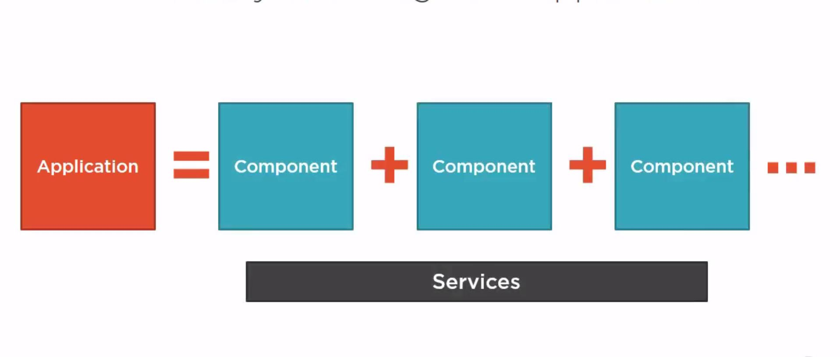
Structure of Angular Js 2

Slide 8
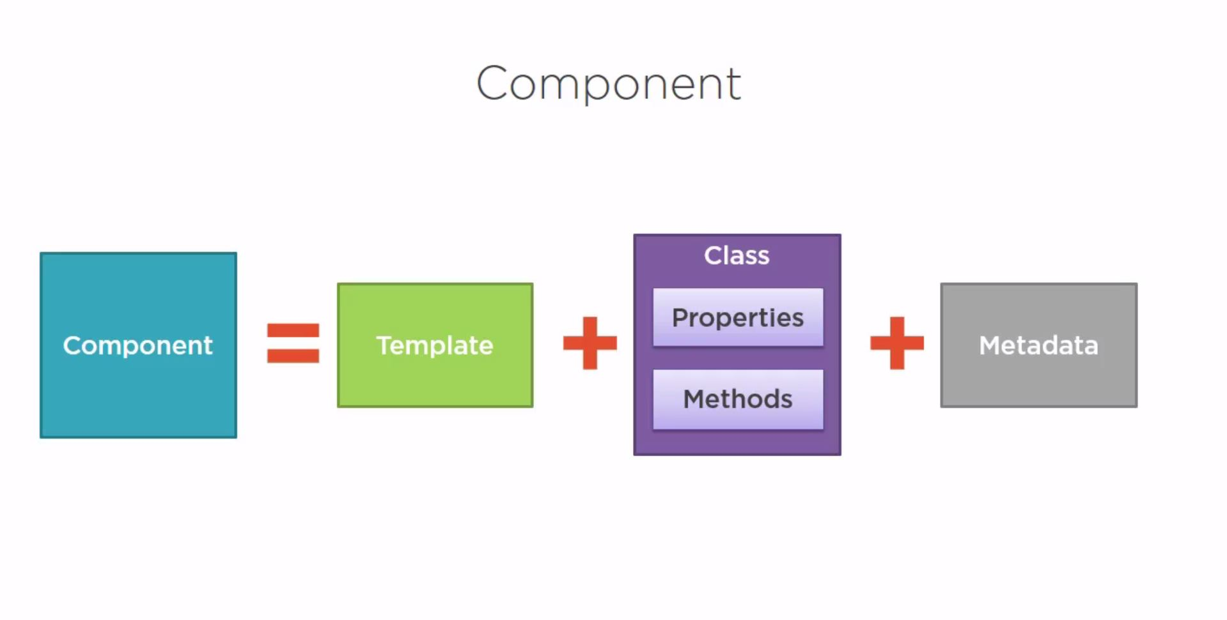
Component

Slide 9
Selecting a Language
ES5(EcmaScrpt 5) – Run in the browser.
ES6(ES-2015) – Lots of new features (classes,let,arrow)
TypeScript – Superset of javascript, Strong typing, IDE
Dart.

Slide 10
What is TypeScipt
Open source language.
Superset of JavaScript.
Transpiles to plain JavaScript.
Strongly typed.
.ts Extension.
Class-Based object orientation.

Slide 11
TypeScript Editors
Visual Studio.
Visual Studio Code.
Atom.
Eclipse.
Others.

Slide 12
Setting Up Our Environment
Npm – Node Package Manager,CLU
Set up the Angular 2 application.
1. Create an application folder.
2. Create the tsconfig.json file.
3. Create the package.json file.
4. Create the typings.json file.
5. Install the libraries and typings.
6. Create the host Web Page(index.html)
7. Create the main.ts file(bootstrapper)

Slide 13
Option to Start
Manually perform each step.
www.angular.io Quick Start.
Download the results of these steps
www.angular.io
AngularCli

Slide 14
Component
What is a Component?
Creating the Component Class
Defining the Metadata with a Decorator.
Importing What We Need
Bootstrapping Our App Component

Slide 15
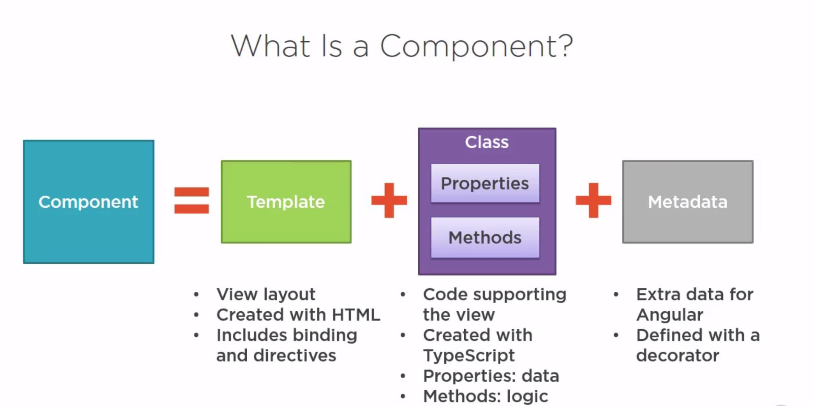
What is a component

Slide 16
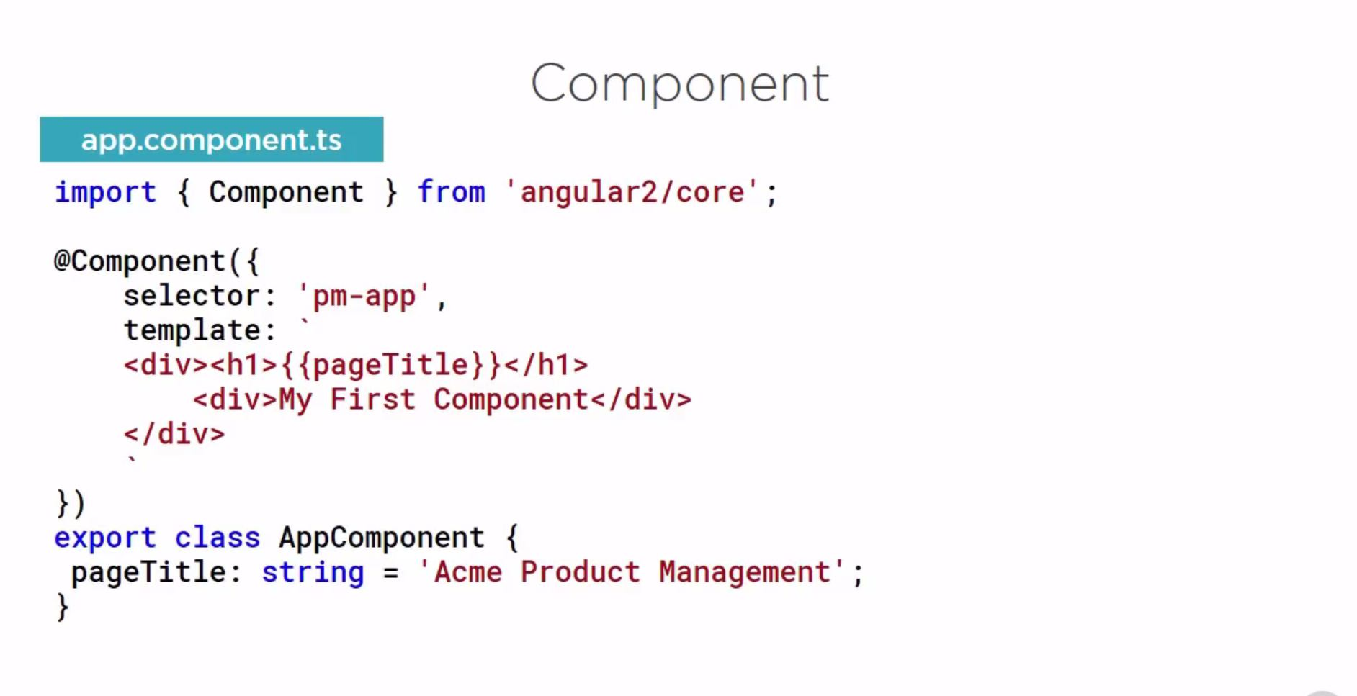
Component

Slide 17
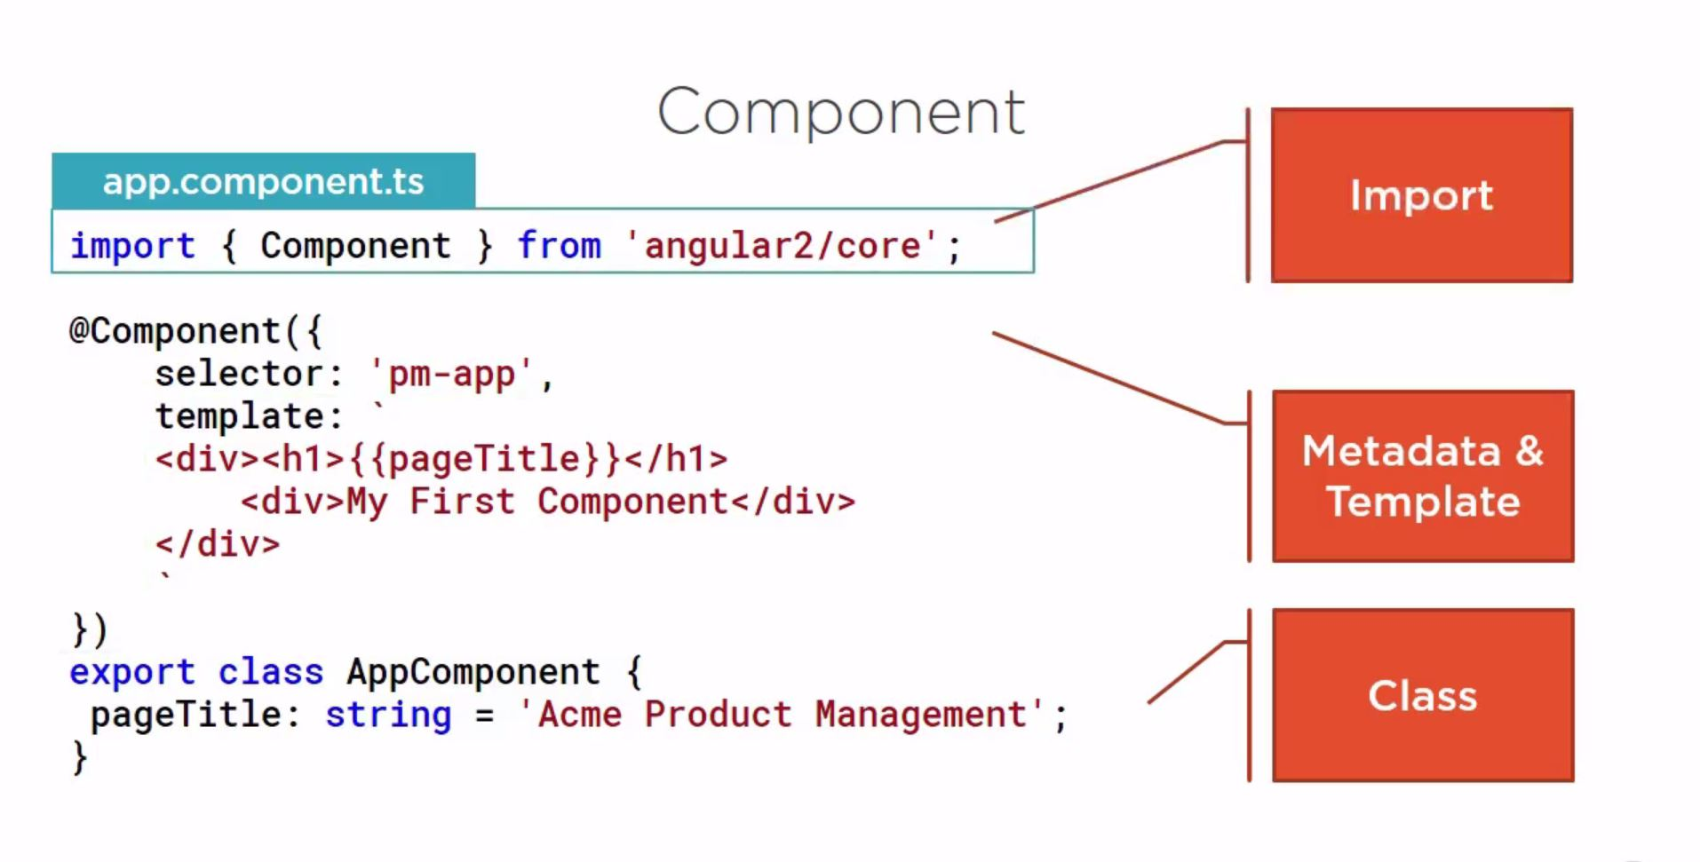
Component detail

Slide 18
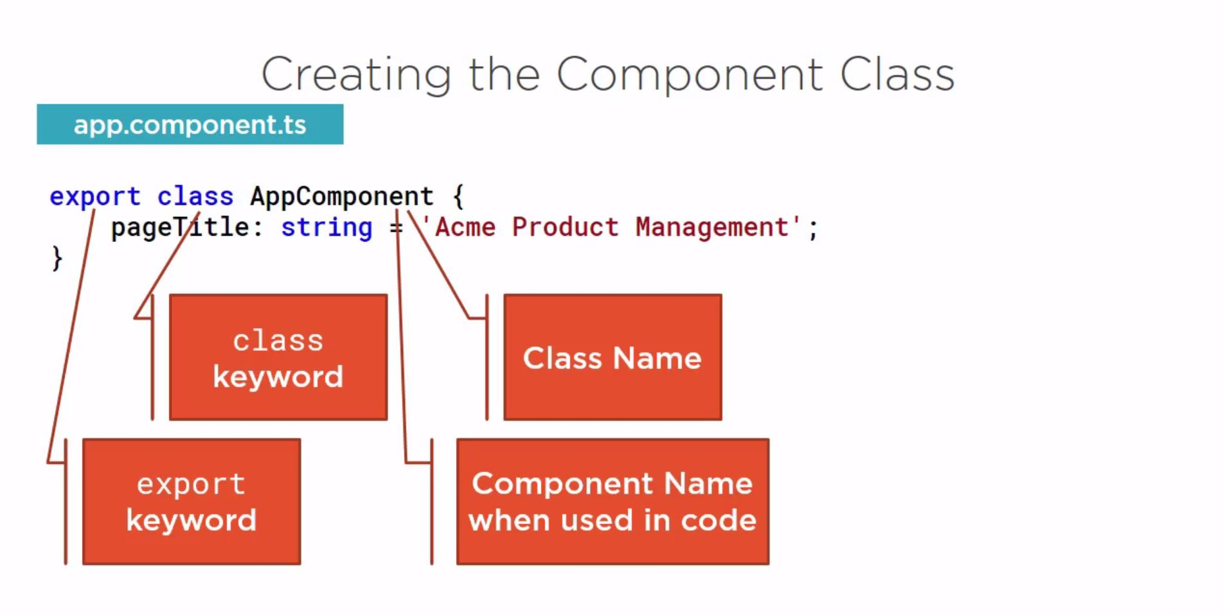
Component Class

Slide 19
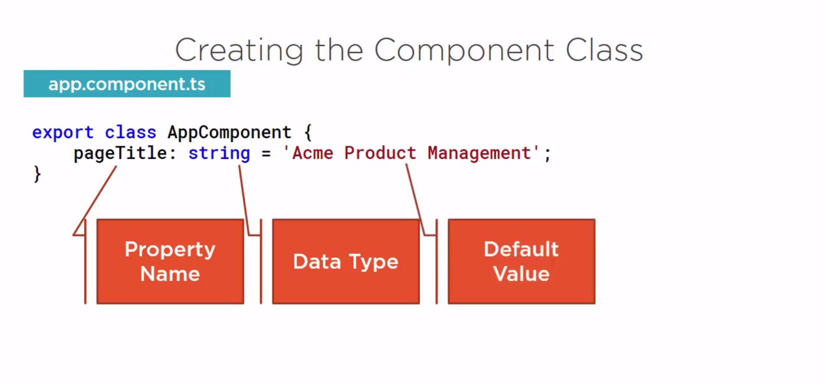
Component Class Properties

Slide 20
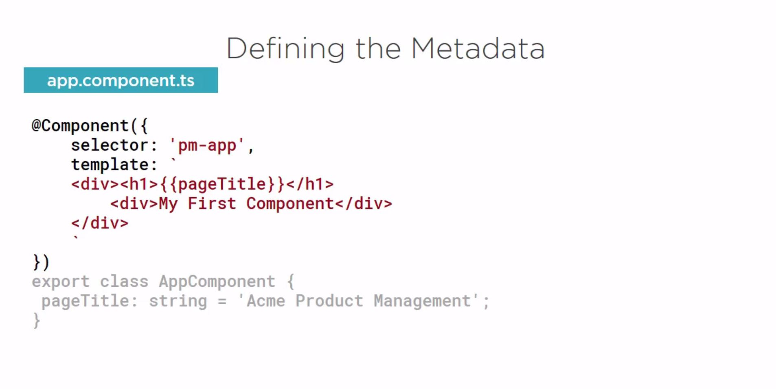
Defining the Metadata

Slide 21
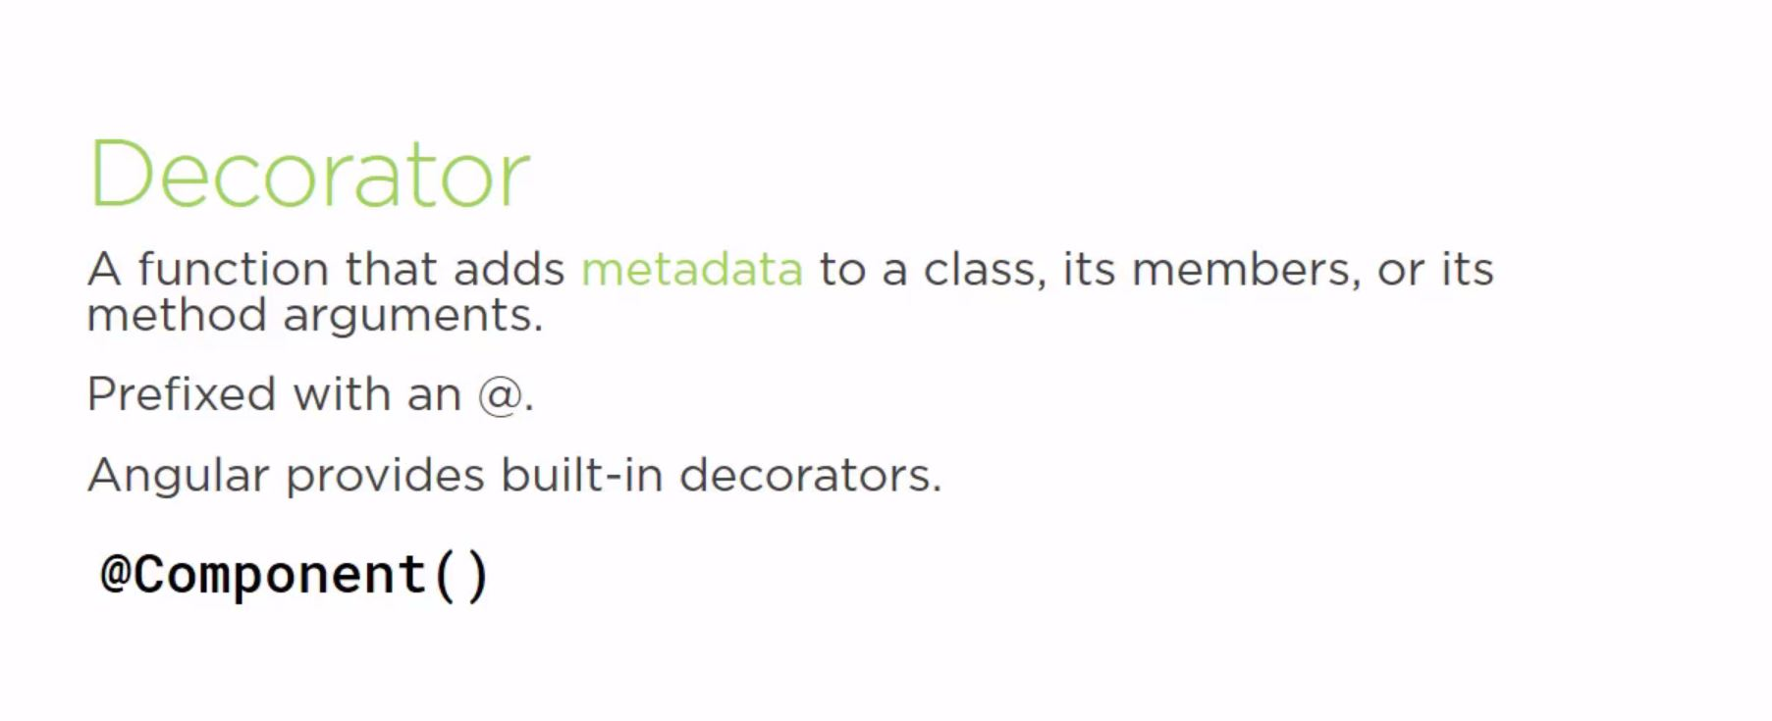
Decorator

Slide 22
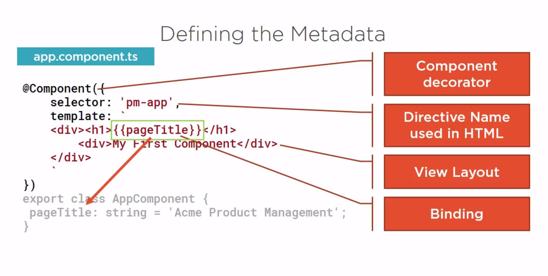
Defining the MetaData

Slide 23
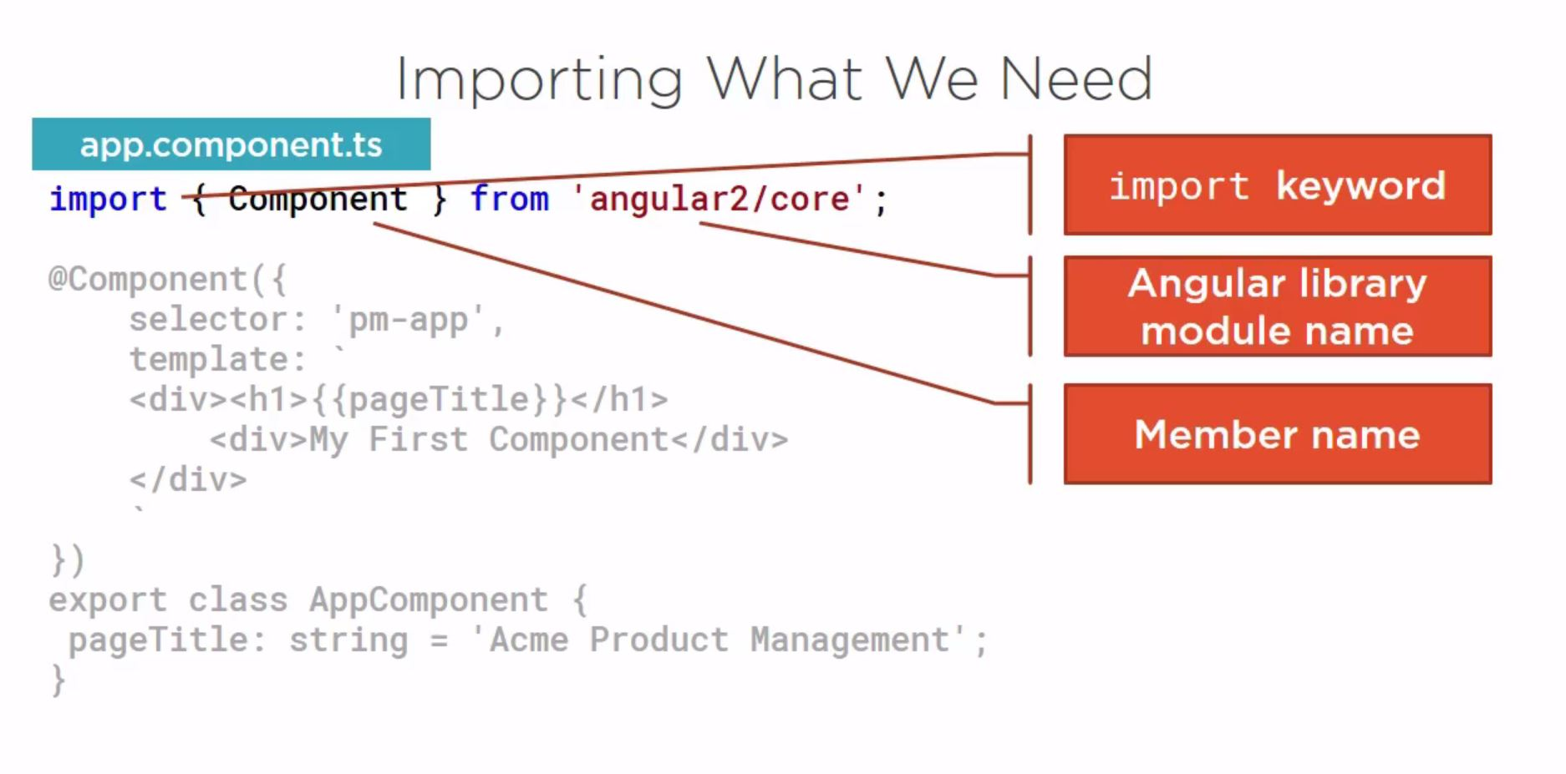
Importing What We Need

Slide 24
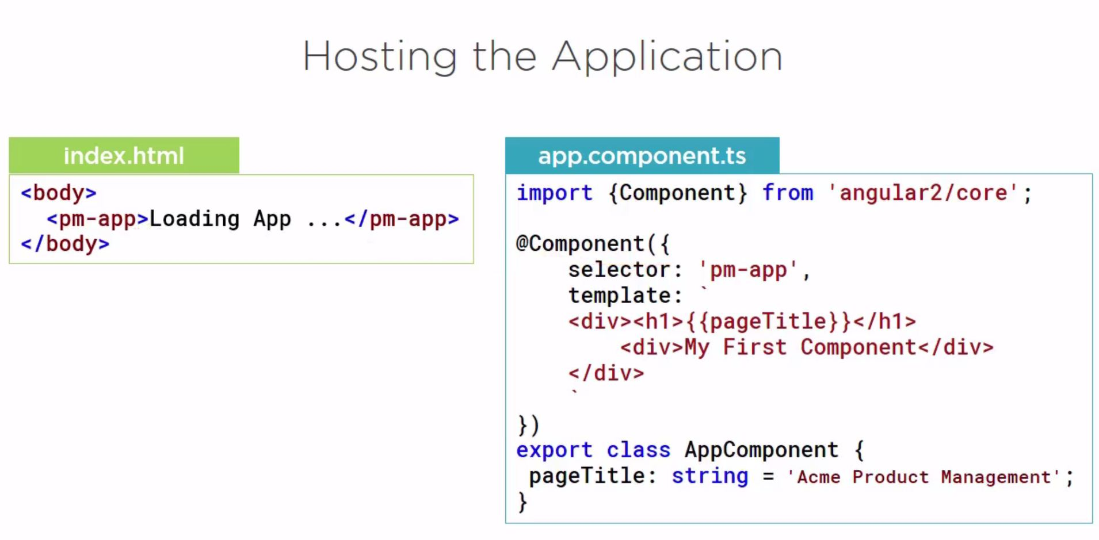
Hosting the Application

Slide 25
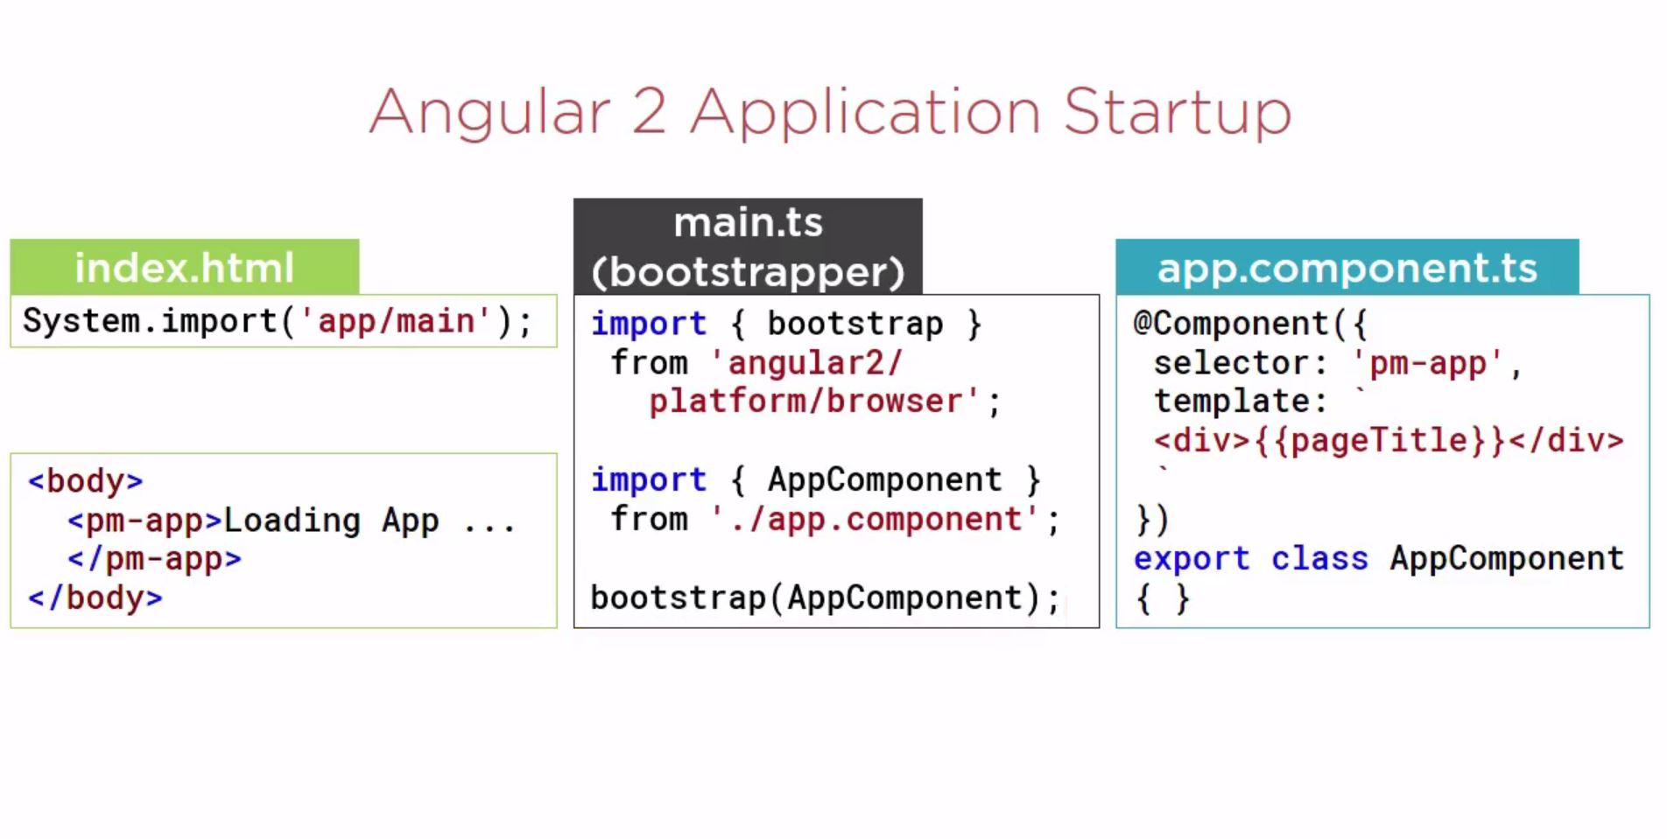
Angular 2 Application Startup

Slide 26
Template, Interpolation and Directives
Building a Template
Using a Component as a Directive
Binding with Interpolation
Adding Logic with Directives

Slide 27
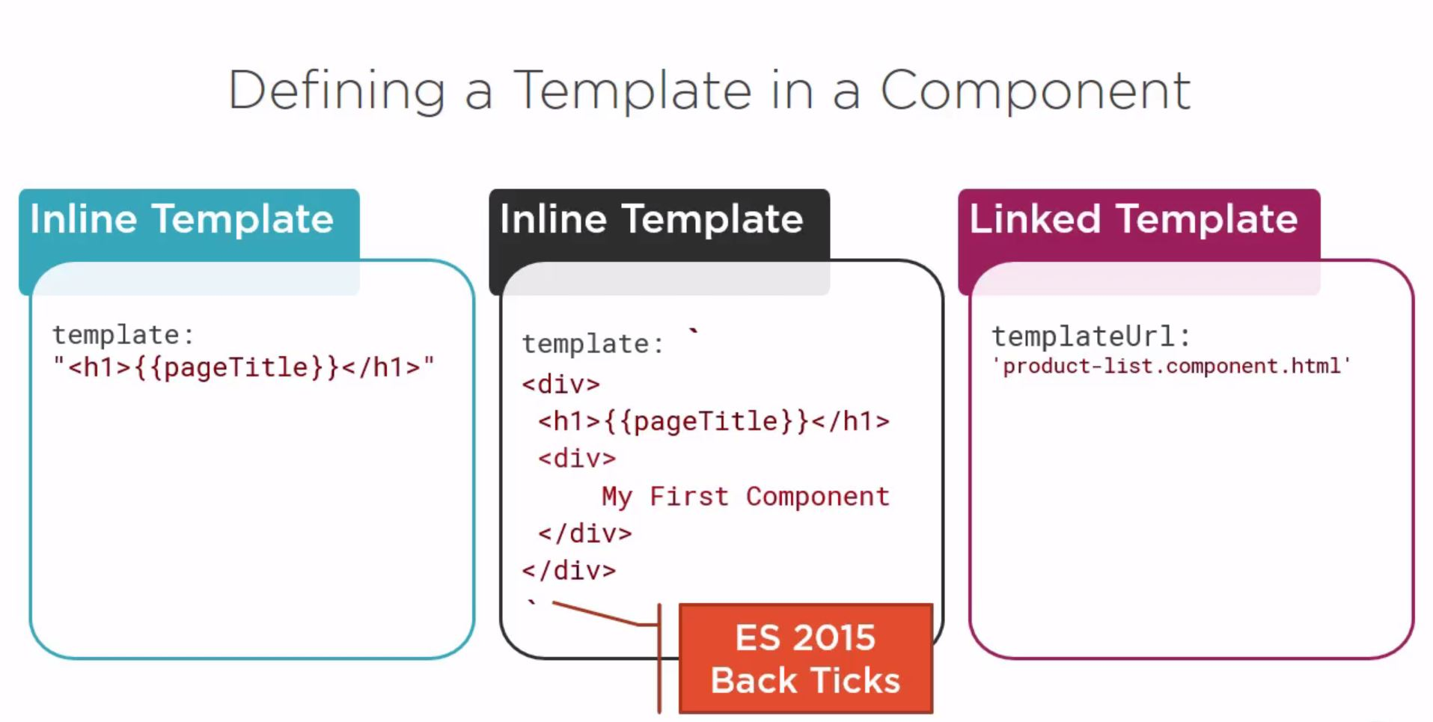
Defining a Template in a Component

Slide 28
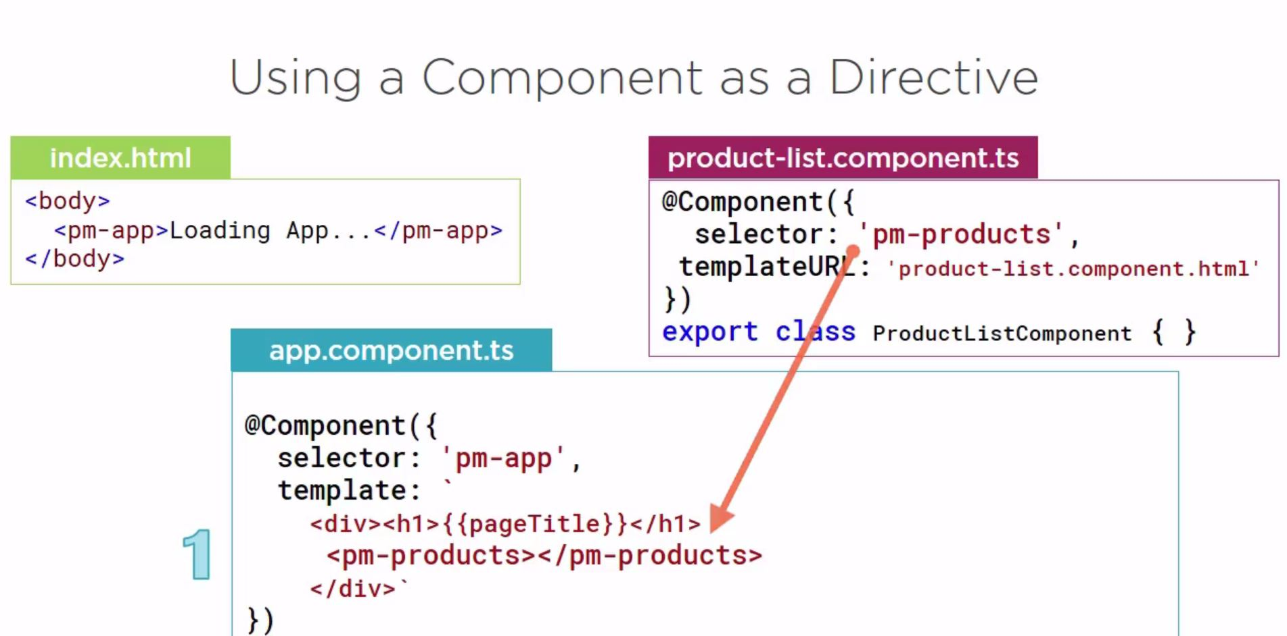
Using a Component as a Directive For Add Step 1

Slide 29
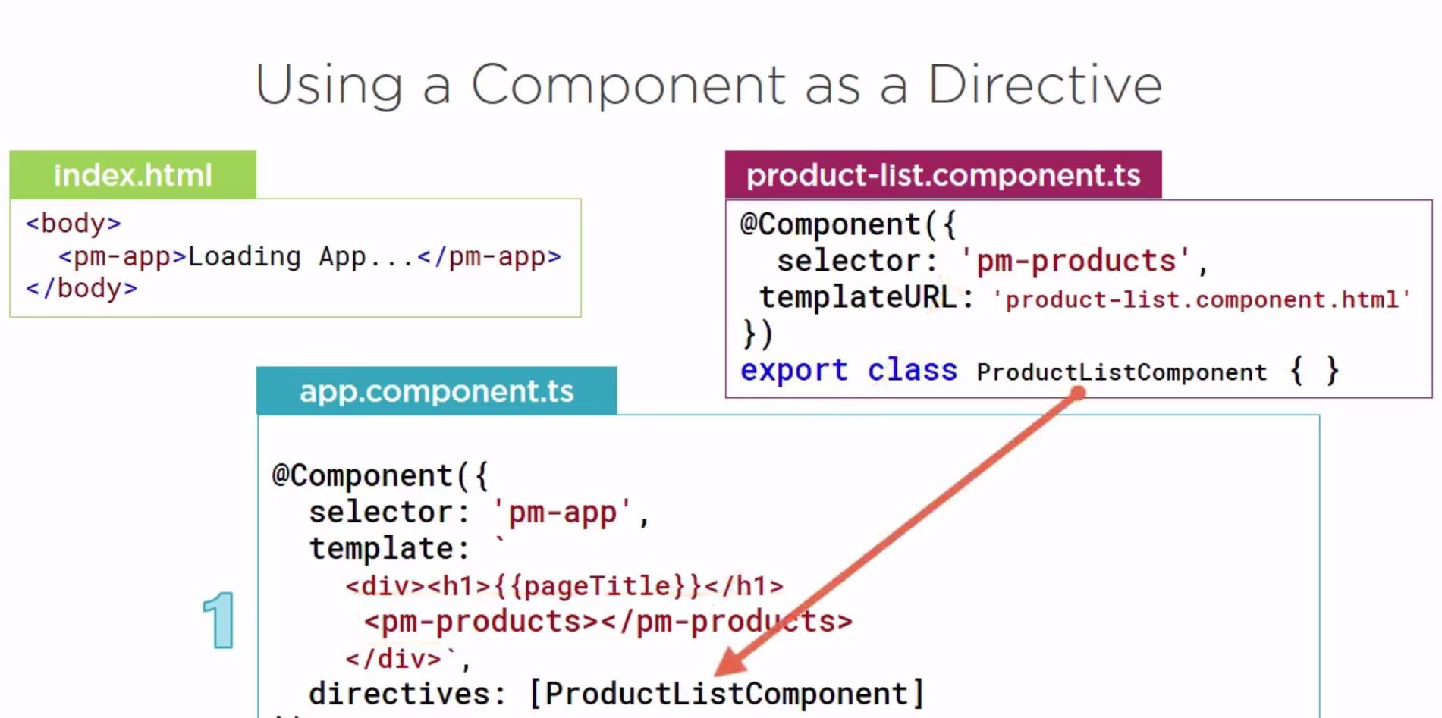
Using a Component as a Directive For Add Step 2.0

Slide 30
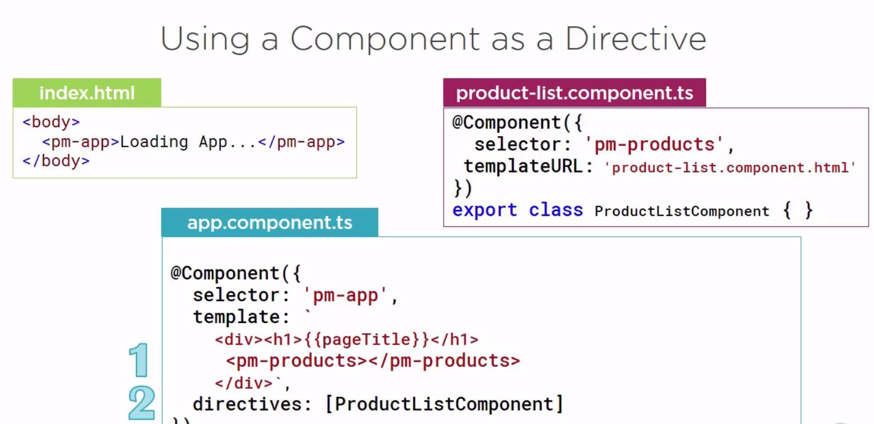
Using a Component as a Directive For Add Step 2.1

Slide 31
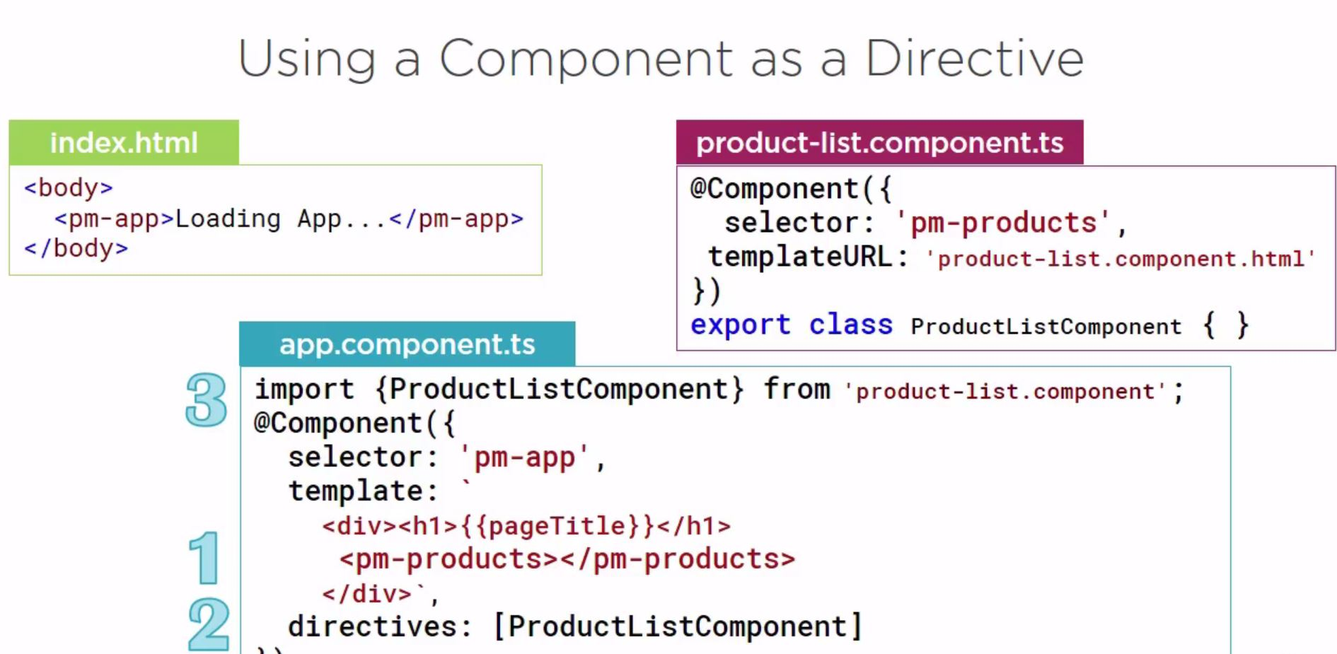
Using a Component as a Directive For Add Step 3

Slide 32
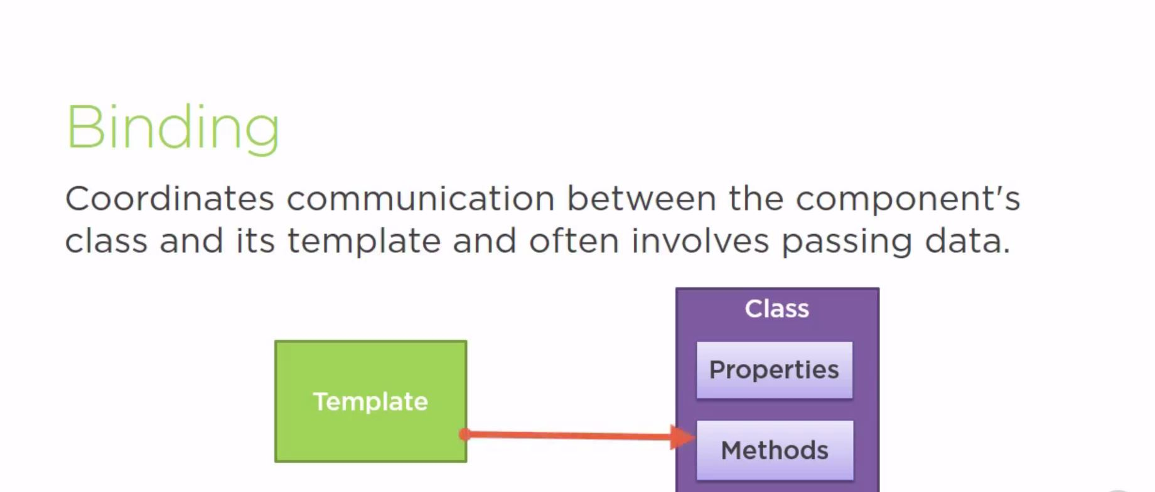
Binding

Slide 33
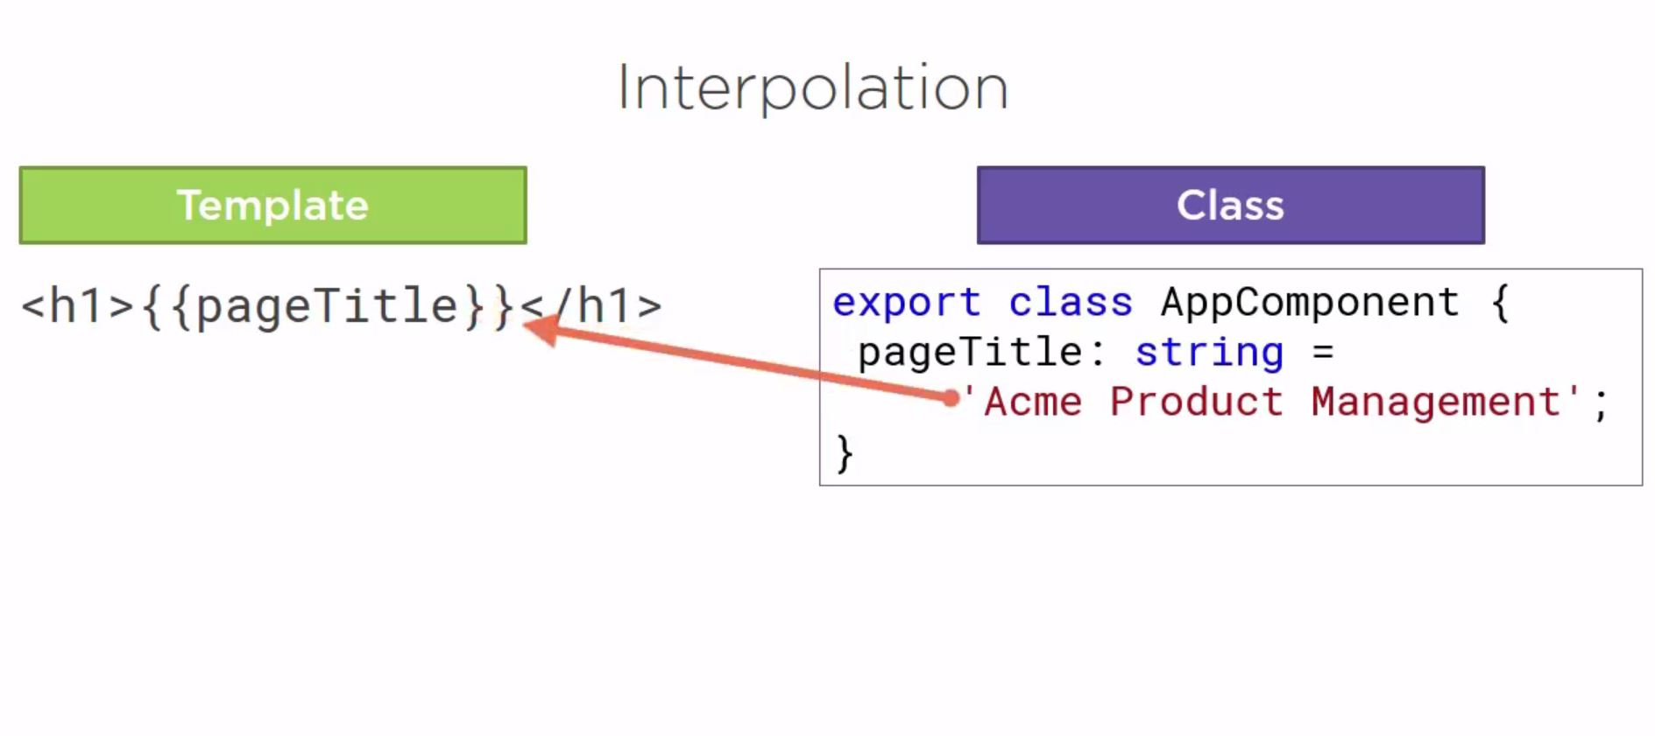
Interpolation

Slide 34
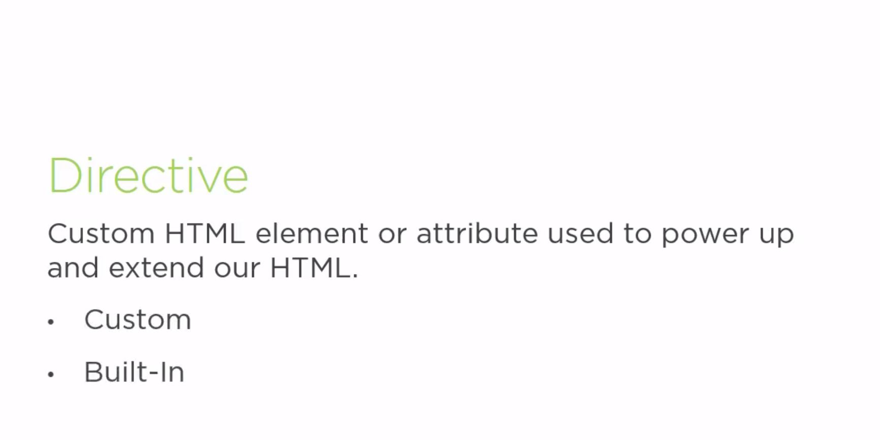
Directive

Slide 35
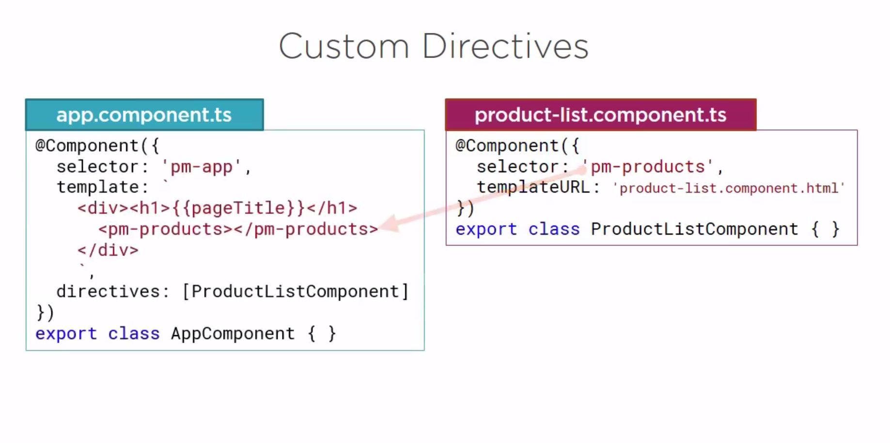
Custom Directive

Slide 36
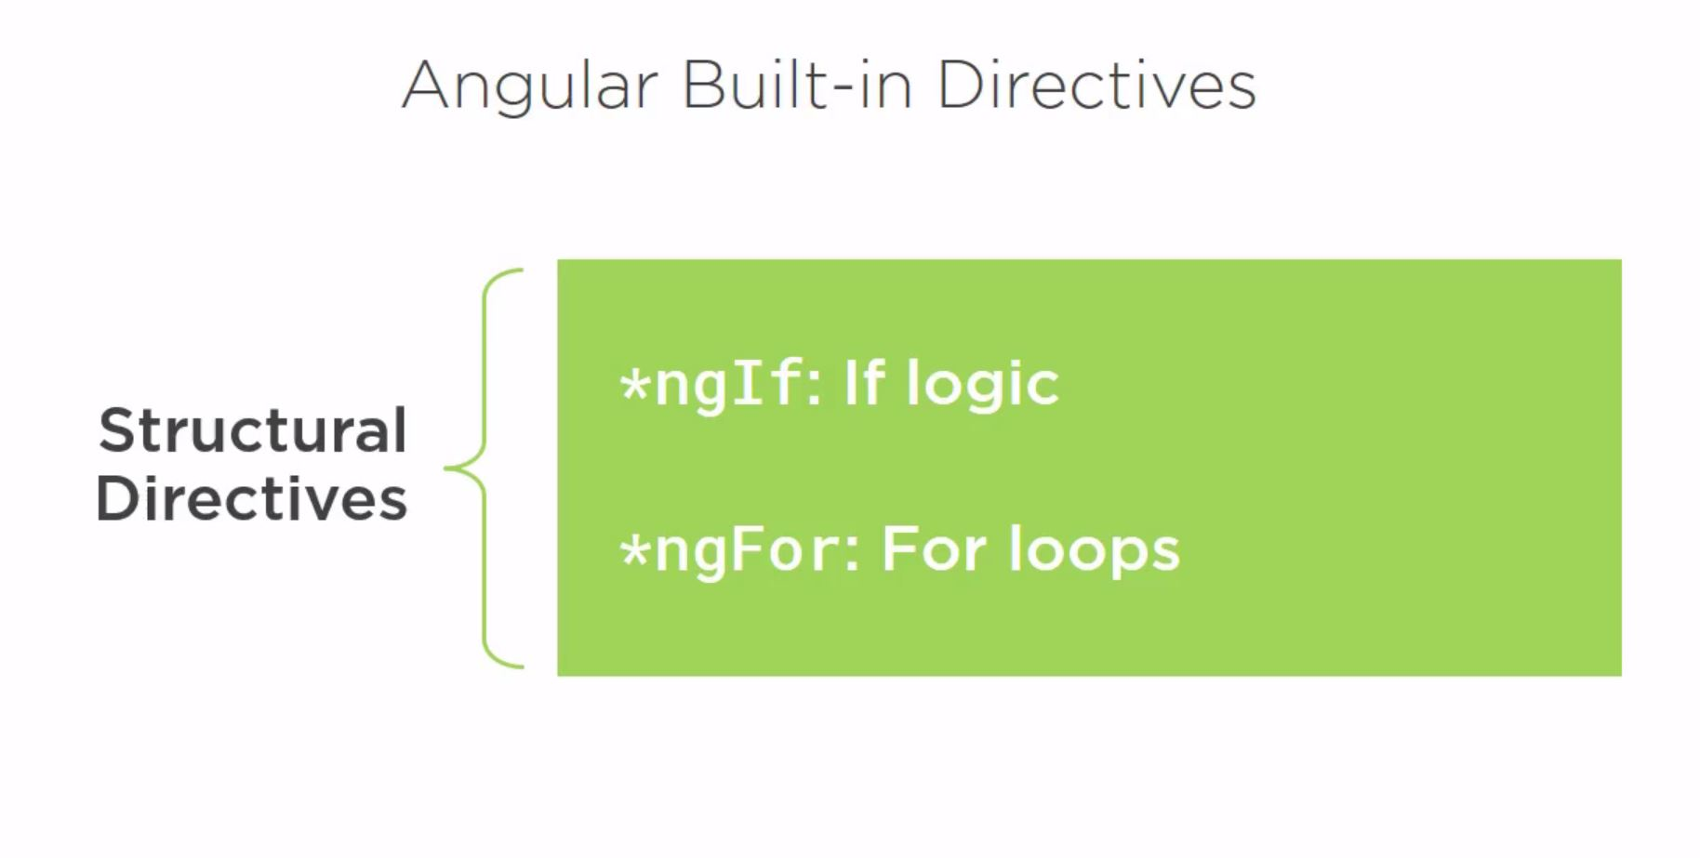
Built in Directive

Slide 37
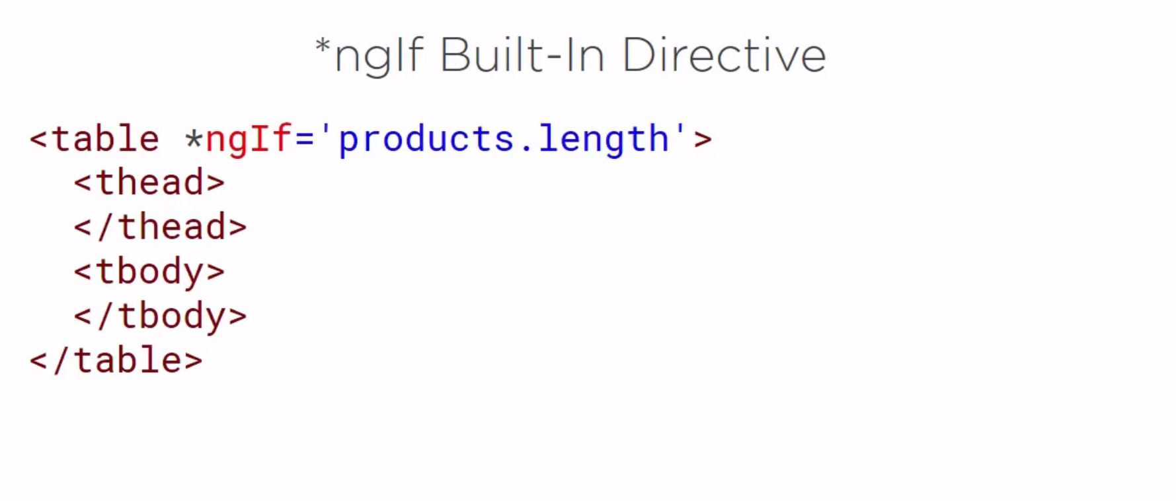
ngIf

Slide 38
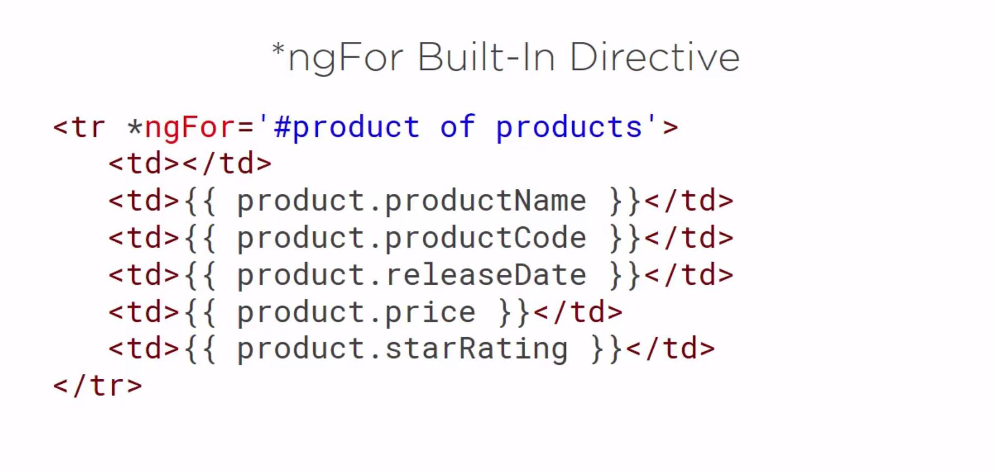
ngFor

Slide 39
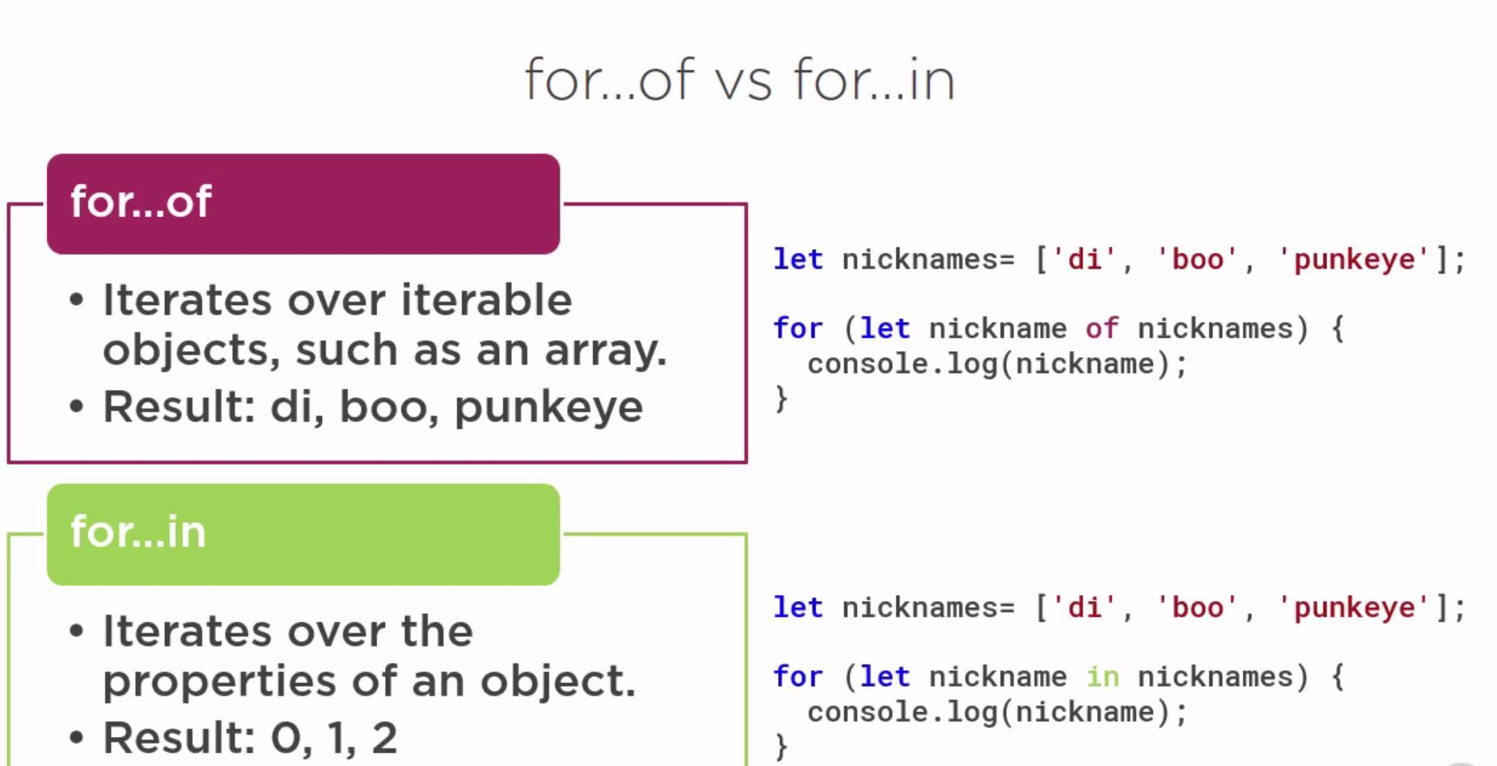
for of vs for in

Slide 40
Data Binding and Pipes.
Property Binding
Handling Events with Event Binding
Handling Input with Two-way Binding.
Transforming Data with Pipes

Slide 41
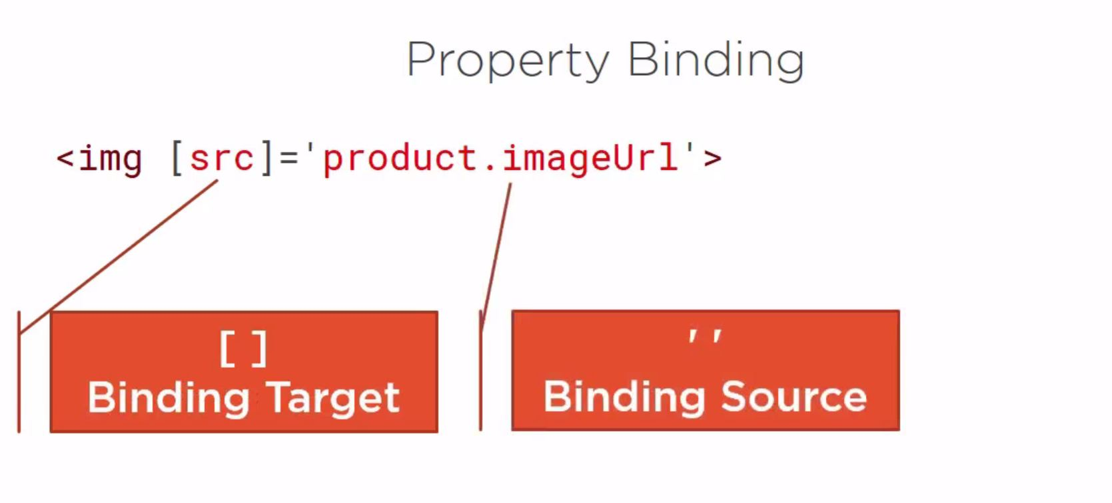
Property binding

Slide 42
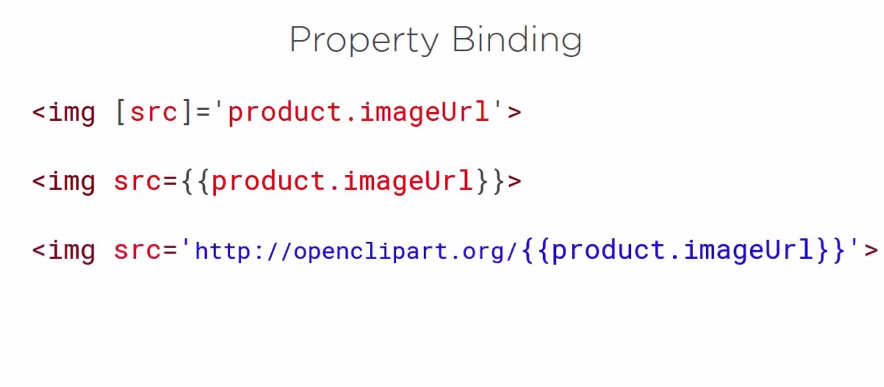
Property Binding Example

Slide 43
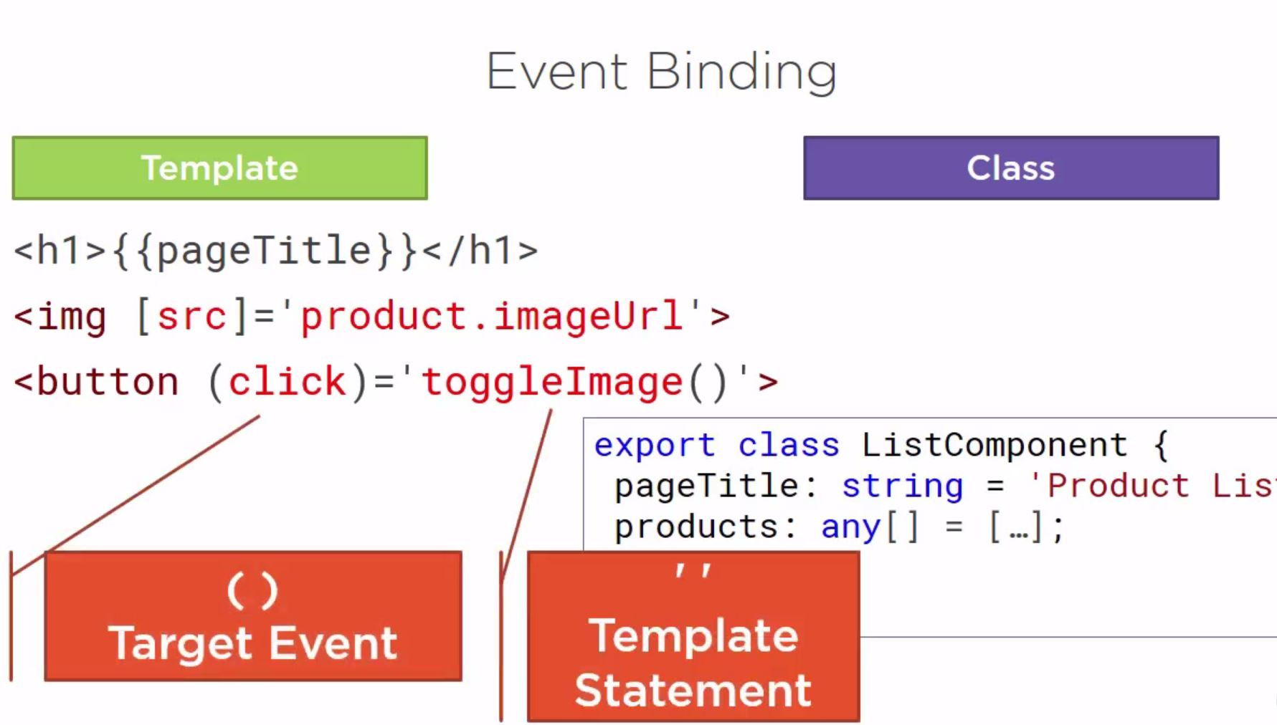
Event Binding

Slide 44
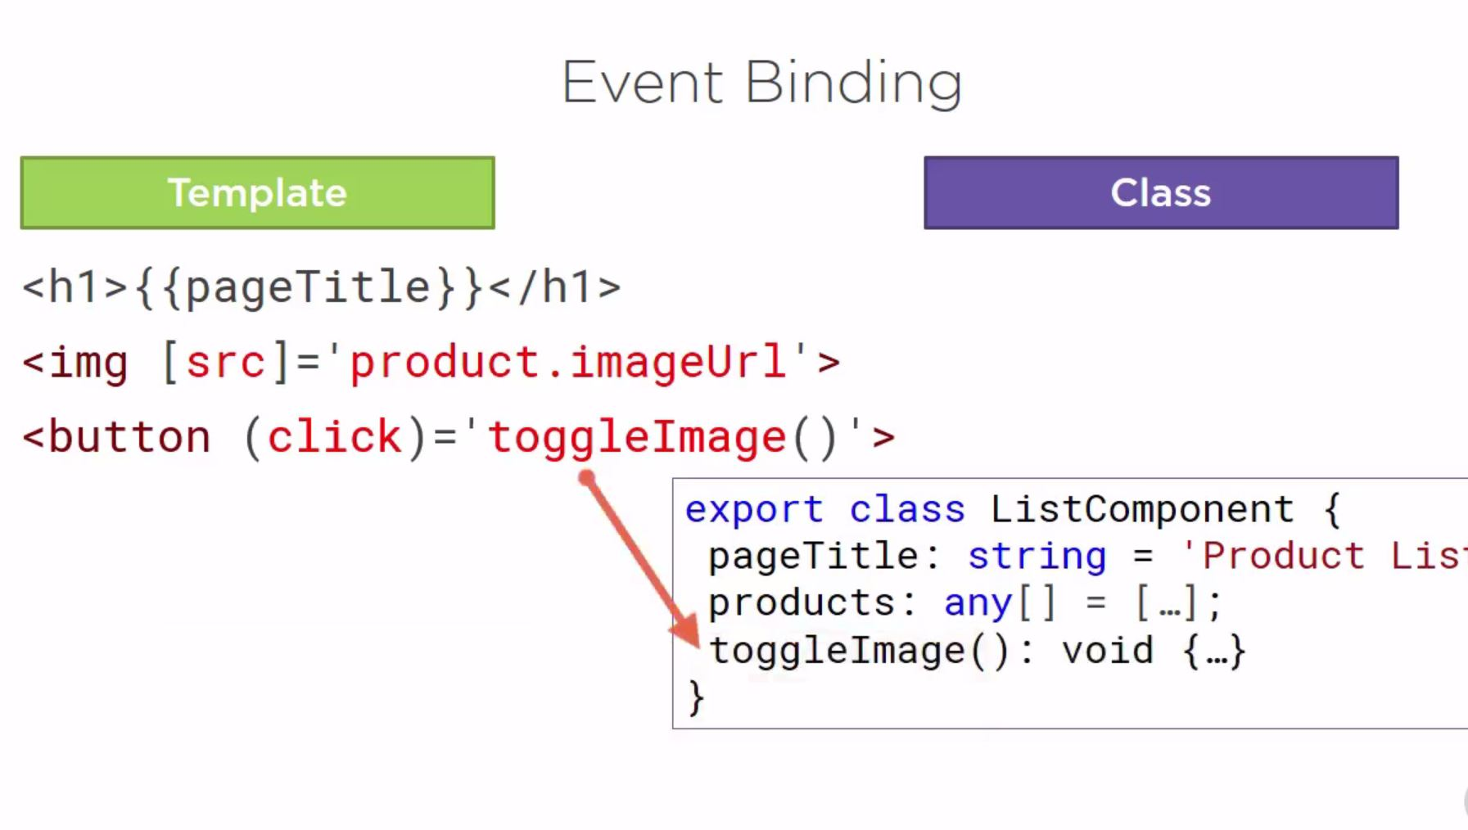
Event Binding

Slide 45
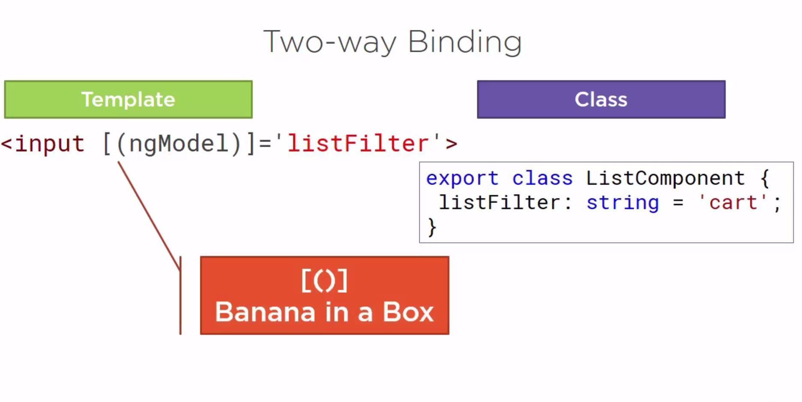
Two Way Binding

Slide 46
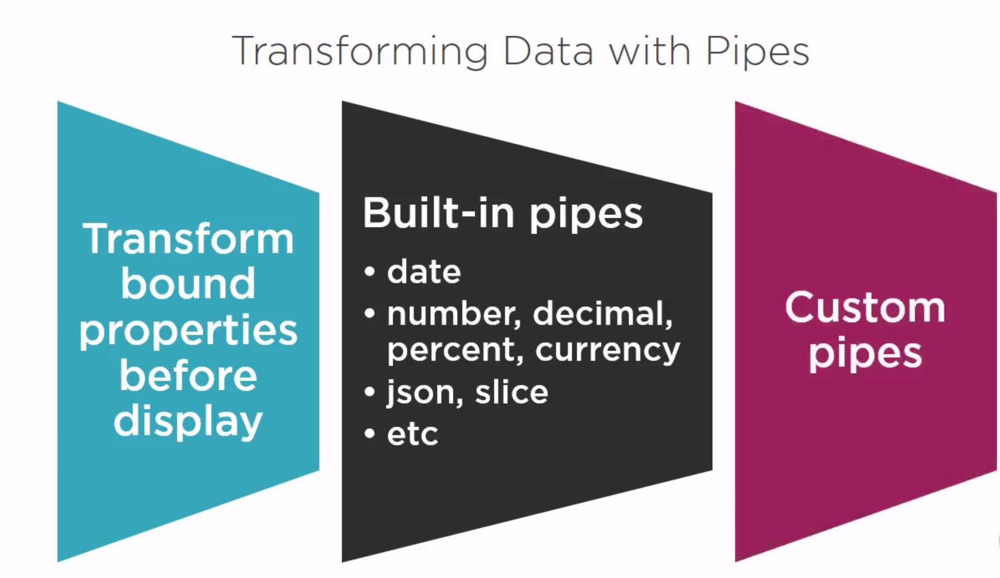
Pipes

Slide 47
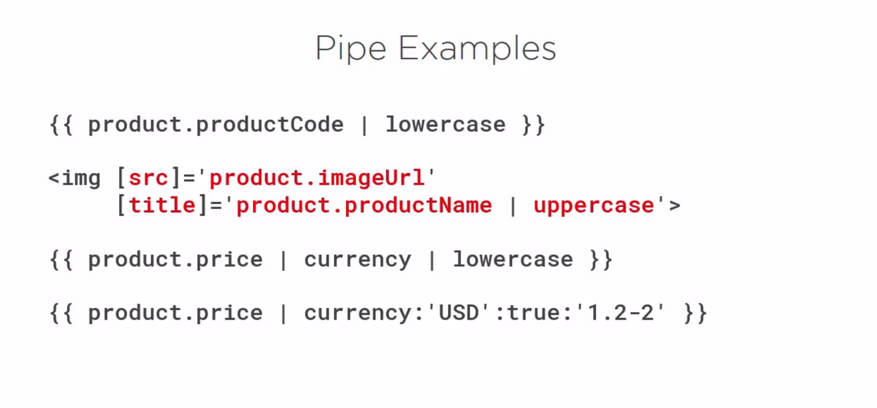
Pipe Example

Slide 48
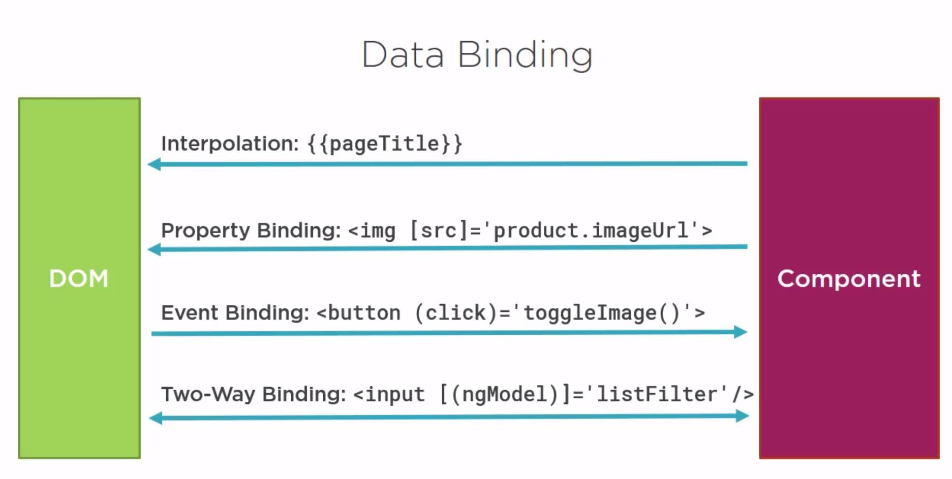
Data Binding Ways

Slide 49
Next Session Will Cover
More on Components.
Building Nested Components.
Service and Dependence Injection.
Retrieve Data using Http
Navigation and Routing.

